Slide 1
Name: W.A.D.N.N Wijesuriya Index Number: 10674049 Module: PRCO303SL Computing Project Course: BSc (Hons) Software Engineering

Slide 2
Human Resource Information System
The Application name is HRIS or Human Resource Information System.
The Human Resource Information System is a human resource management system that helps HR managers to manage and communicate with employees in the organization.
It Benefits human resource managers and employees in an organization.
The Project consist of a WEB application and a MOBILE application.
An Intense amount of Research was done in order to make it a successful project.
The project was reviewed at multiple stages during development in order to see if it meets the quality plan and also to see whether required functionalities were achieved.

Slide 3
Problem Identification
How to improve the management of employees, how to improve the efficiency of employees while reducing the mundane tasks of Human Resource Managers and improving the communication within the organization.

Slide 4
Research Result
Identified what the human resource managers need in order to manage employees
Limitations of the existing systems
What the employees needs
The mundane tasks of HR managers
The wants of HR managers and Employees in an enterprise application
The Questioner Used for research of the project can be accessed from this link: https://docs.google.com/forms/d/1ZiRryGIO-P6wBrgX15H9ibOp6ZuKEoSJh8Oe2fP-sds/edit#responses

Slide 5
Business Needs and Wants
Automate some of the tasks done by employees to make them more efficient
Provide human resource managers with informational data on the business to make important decisions for the betterment of the business
To manage staff more efficiently and in an easy way
To have a good communication between management and employees
To motivate employees and provide a good working environment
To ensure that organization resources are used efficiently
To have accurate data within the business

Slide 6
Objectives Of The Project
Identify what are the functionalities that the human resource managers need.
Identify what are the tasks done human resource managers that could be automated.
To provide a way to improve the communication.
Create a good working environment within the organization.
To make the decision-making process of human resource managers easier.
To keep the employees up to date.
To provide a way to manage employees effectively within the business.
To Provide self-service capabilities for employees in the business.

Slide 7
Summary Of The Project Scope
Identify what are the human recourses information systems in the current market and find what are the positives and negatives of these systems.
Identify the human resource process what the human resource managers need to make decisions using questioners
Develop a mobile and web application for employees and the human resource managers.
Implement all the required functionalities identified for a human resource managers.
Implement functionalities that was requested and functionalities that would improve the application

Slide 8





Technologies Used

Slide 9

Learning Undertaken For The Project

Slide 10
Project Timeline & Method Of Implementation
Project Plan
Stage | End date | Products/deliverables / outcome
Project Initiation | 03/11/2020 | Project initiation document
Research on the development area | 05/11/2020 | A clear understanding of what human resource managers need and the short comings of the current HRIS systems
High Level designs of the system | 10/11/2020 | Design documents that are needed for the project and graphical user interface layouts
Increment 1 | 10/02/2021 | Development of the functionalities for human resource managers in the web and mobile application
Increment 2 | 15/03/2021 | Development of the functionalities for employees in the web and mobile application
Increment 3 | 15/04/2021 | Integration of machine learning and some of the other functionalities
System testing | 29/04/2021 | Testing the entire system

Slide 11
Benefits From The Project
Help HR Managers to do certain task
Reduce mundane tasks done by HR Managers
Improves communication between managers and employees
Help monitor and manage employees effectively
Motivate employees and provide a good working environment
Automate some of the tasks done by employees and HR mangers to make them more efficient
Provide human resource managers with informational data on the business to make important decisions for the betterment of the business
Contains accurate data within the organization

Slide 12
Difficulties Faced During Development
The Covid-19 pandemic
Schedule Over Run
Technical Difficulties

Slide 13
Reviews Done On the Project
Supervisor Meetings
Reviews from fellow batchmates
Reviews from undergraduates studying in HR Management
Reviews from HR Managers working in organizations

Slide 14
Changes Made Based On Reviews
The attendance management of the application was improved
The presence system of the application was improved
The document management of the application was improved
The functionalities of the employees was improved
The employee and HR managers review system was also improved

Slide 15
Quality Plan For The Project
Quality Plan
Quality check | Strategy
Major deliverables | To ensure that the major deliverables are met a plan is made on the work process so it is not rushed this will also ensure that the system has the functionalities mentioned and nothing will be missed.
Quality control activities throughout the project | To ensure the quality I will get a review from my supervisor after each increment of the project and during the testing period of the system
Sub system usability and validation | This will be done after each increment to ensure quality is maintained in the project
Quality assurance activities | To ensure that the quality of the application is maintained I will get the review of the quality from my supervisor after each stage.
Feasibility study | A feasibility study will be done on the project to ensure that the project is worth the time and effort and to show how it will benefit the business.
System validation and user acceptance | To ensure that the human resource managers accept the product and is also helpful to them a questioner was conducted of what they need and what they want from a human resource information system. So, it could be delivered to them. In addition, I will also get the option of my supervisor.

Slide 16
Future Improvements
Improve the Analytics section of the application by adding machine learning
Taking the PWA technology further and creating a desktop application
Using facial recognition for attendance section of the application
Adding more functionalities for the employees

Slide 17
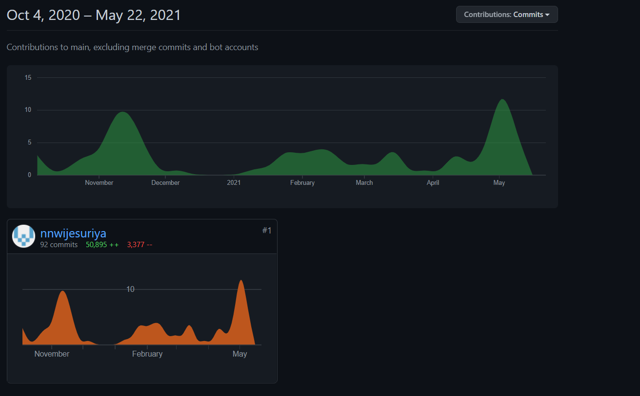
My Commits Through Out The Year

Slide 18
Demonstration Of The Application
Database Of The Project

Slide 19
Thank You!!!

